Slide 1

Distributed Machine Learning in Heterogeneous Edge Networks
Mahmoud Sajjadi
Advisor: Dr. Lei Yang
Committee members: Dr. Lei Yang (Chair), Dr. Feng Yan,
Dr. Ping Liu, Dr. Rui Hu, Dr. Hao Xu
Computer Science and Engineering
University of Nevada, Reno
Notes:
Ph.D. proposal titleAcknowledge advisor & committeeMotivation, challenges, proposed solutions

Slide 2

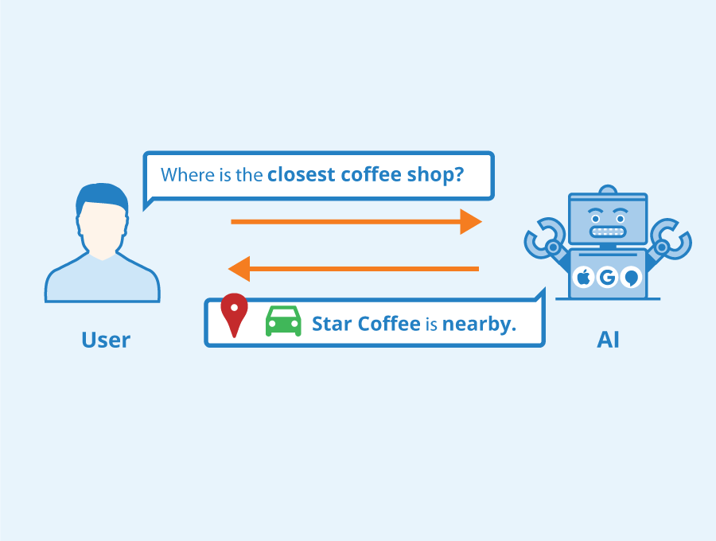




Centralized Machine Learning
Computer vision
High communication demand
Natural Language Processing (NLP)
Security / privacy issues
Data
Server
Speech processing

Slide 3


Centralized Federated Learning
Server
Edge Networks

Slide 4







Centralized Federated Learning: System Heterogeneity
Heterogeneity issues
Computation
Communication
Dataset/task size
Server

Slide 5

Decentralized Machine Learning
Edge networks are growing
Communication with a central server is costly
Server bottleneck in large heterogeneous edge networks
Server

Slide 6

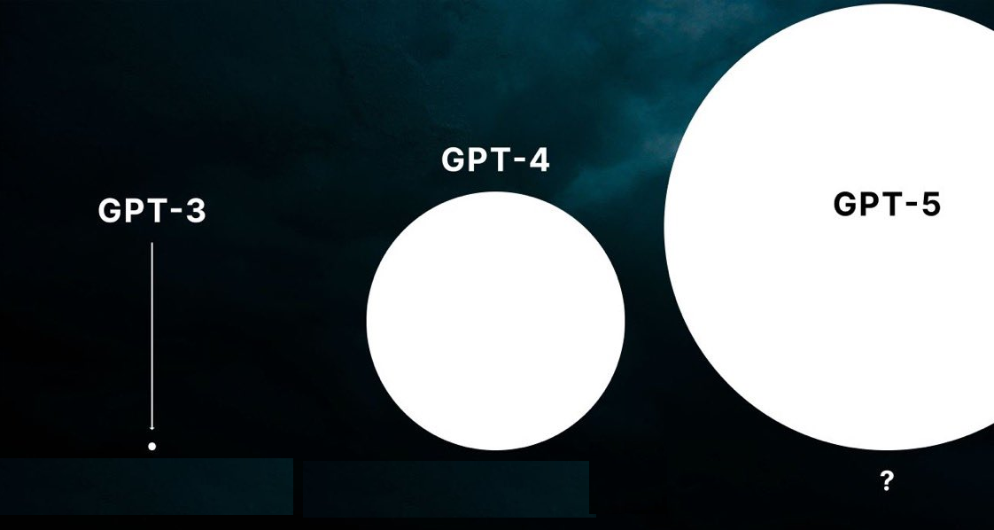


Exponential LLM Growth: The Communication Challenge
Storage / Communication: 100s GB Even with PEFT: 10s GB
175 B
1.8 T

Slide 7
Outline
Heterogeneity of Edge Devices
Decentralized Machine Learning
Communication & Storage Overhead

Slide 8
Heterogeneity of Edge Devices
Dynamic Tiering-based Federated Learning (DTFL)

Slide 9


Centralized Federated Learning — Literature Review
Client-side
Server-side
Agents
Key Challenges
Dynamic client and environments
Consideration of both communication and computation costs
Aggregator server
Computing server
Centralized Federated Learning
  HB McMahan, 2016
  TiFL and FedAT, Z Chai, 2020 and 2021
Split Learning
  P Vepakomma, 2018
  Local loss FL, DJ Han, 2021
  SplitFed, C Thapa, 2022
Notes:
agent and server sides
often face device heterogeneity and straggler agents
grouped into tiers, balance
Model Splitting, reducing the computational burden
Local loss training

Slide 10
Dynamic Tiering-Based Federated Learning
Server
Fastest client
Slowest client
Largest model
Tier 3
Tier 2
Tier 1
Smallest model
Notes:
Consider a scenario with hetero ….
Example

Slide 11
Dynamic Tiering-Based Federated Learning
Clients download their client-side models based on the assigned tier
Server
1
Forward propagation
Server-side local loss
2
3
Clients train their client-side models locally
1
1
1
2
2
2
Server trains server-side models
4
Client-side local loss
Server aggregates and updates models
3
3
3
5
Tier 3
Tier 2
Tier 1

Slide 12
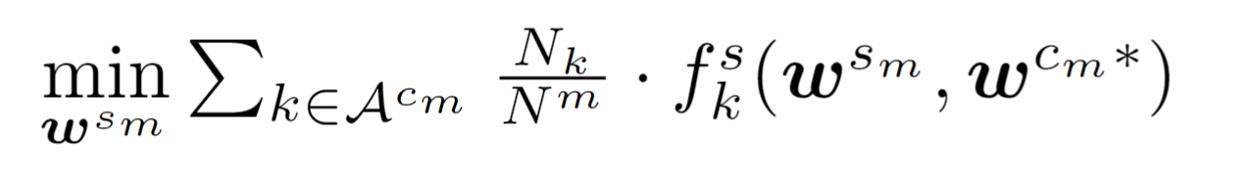
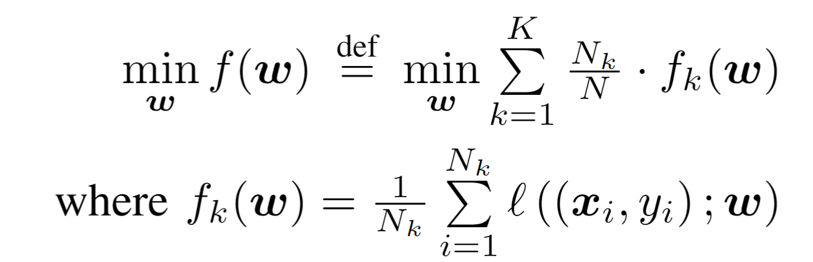
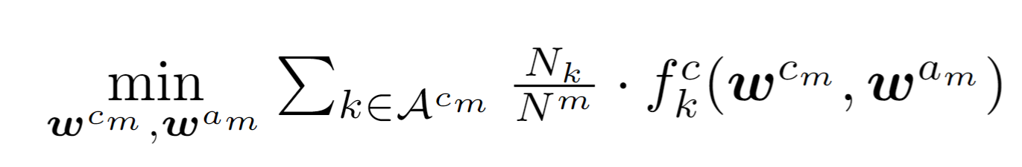
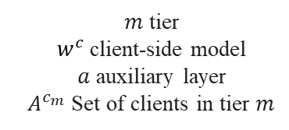

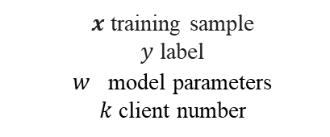
Distributed Machine Learning
$w^{s}$ server-side model
Goal: Minimize training time
$x$ training sample
$y$ label
$w^{}$model parameters
$k$ client number
$m$ tier
$w^{c}$client-side model
$a$ auxiliary layer
$A^{c_{m}}$ Set of clients in tier $m$
Notes:
Simplify math here
$w^{c_{m}^{∗}}$ optimal client-side model

Slide 13
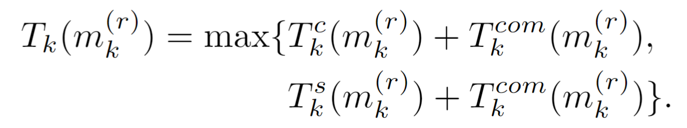
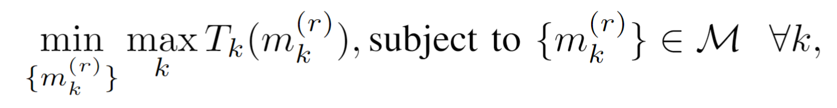
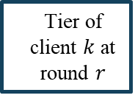

Training Time of Distributed Machine Learning
$M$ set of all tiers
Tier of client $k$ at round $r$
Slowest client
Dynamic heterogeneous environments
Notes:
Simplify math here
we analyze the total training time

Slide 14
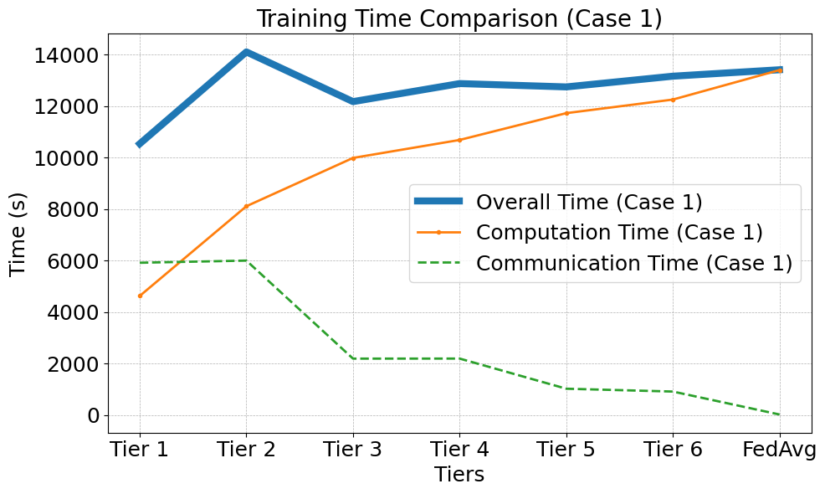
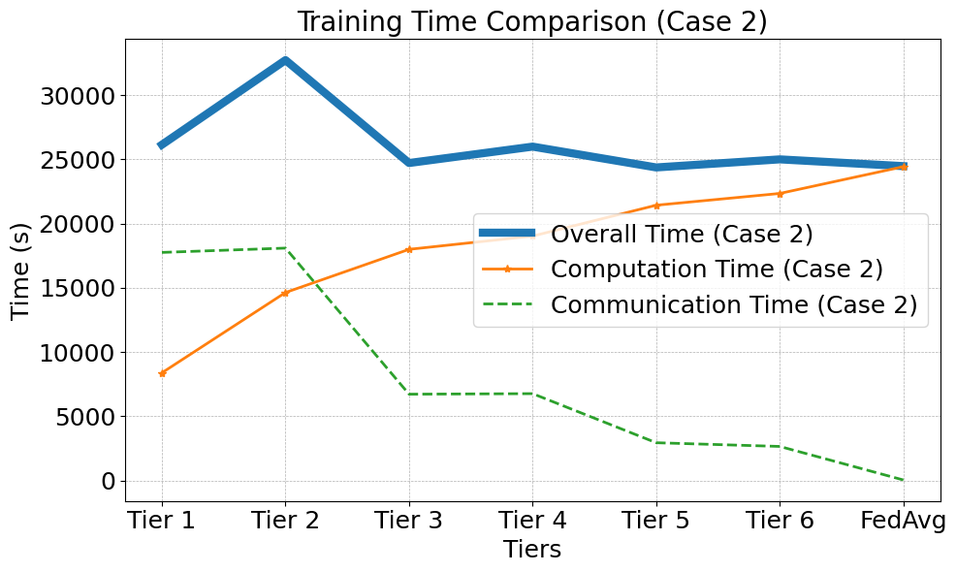
Key Observation - Impact of Tiering on Training Time
Factors: communication, processing
Trade-off: communication and computation
Dynamic tiering to minimize training time
Minimum training time

Slide 15



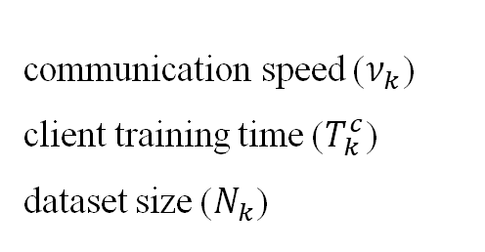
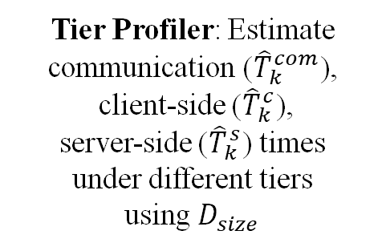
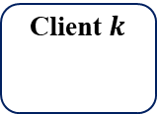

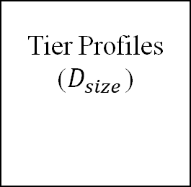
Dynamic Tier Scheduler – Tier Profiler
Estimate training time under different tiers
communication speed ($ν_{k}$)
client training time ($T_{k}^{c}$)
dataset size ($N_{k}$)
Dynamic Tier Scheduler
Tier Profiler: Estimate communication (${\hat{T}}_{k}^{com}$),
client-side (${\hat{T}}_{k}^{c}$),
server-side (${\hat{T}}_{k}^{s}$) times
under different tiers
using $D_{size}$
Tier Profiles ($D_{size}$)
Client $k$
Tier 1
Tier 2
Tier $M$
…

Slide 16
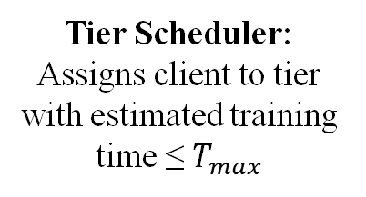
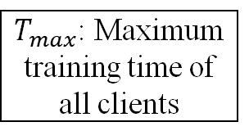
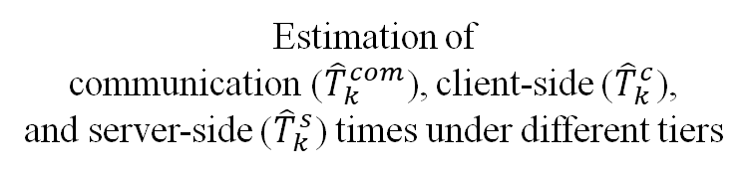


Dynamic Tier Scheduler – Tier Scheduler
Assign clients to the most suitable tier for each training round
Dynamic Tier Scheduler
$$T_{max}←\max_{k} \min_{ m} \left\{{\overset{ˆ}{T}}_{k}\left(m_{k}^{\left(r+1\right)}\right)\right\}$$
Estimation of
communication (${\hat{T}}_{k}^{com}$), client-side (${\hat{T}}_{k}^{c}$),
and server-side (${\hat{T}}_{k}^{s}$) times under different tiers
Client $k$
Tier Scheduler: Assigns client to tier with estimated training time ≤ $T_{max}$
$T_{max}$: Maximum training time of all clients
$$m_{k}^{\left(r+1\right)}←arg{\max_{m}} \left(\left\{{\overset{ˆ}{T}}_{k}\left(m_{k}^{\left(r+1\right)}\right)≤T_{max}\right\}\right)$$

Slide 17
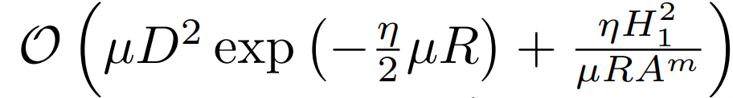
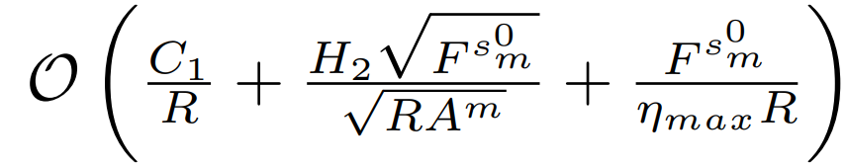
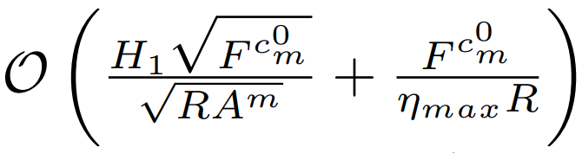
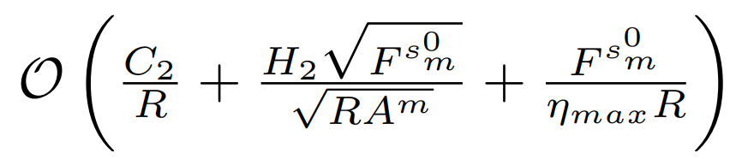
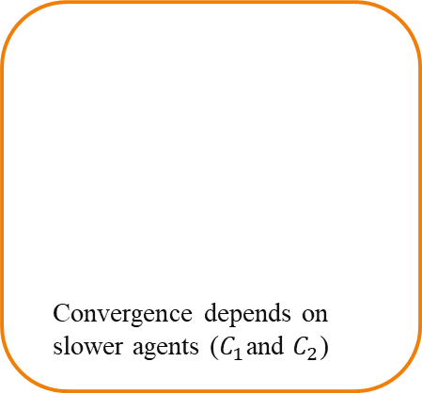
Convergence Analysis
Theorem: Client side and server side models for both convex and non-convex functions converge with DTFL algorithm
 | Client side | Server side
Convex
Non-convex
Similar convergence rates to FL
Convergence depends on slower agents ($C_{1}$and $C_{2}$)

Slide 18

Evaluation Setup
Implementation:
  Hardware: Intel Xeon(R) CPU & NVIDIA GeForce GTX GPUs
  Software: Python, PyTorch
  Heterogeneous simulation environment
    4, 2, 1, 0.2, and 0.1 CPUs.
    10, 30, and 100 Mbps
Model Architecture:
  ResNet-56
  ResNet-110
Baselines:
  FedAvg
  SplitFed
  FedYogi
  FedGKT
Datasets:
  CIFAR-10, CIFAR-100, CINIC-10, HAM10000
  Non-IID variants for label distribution skew
Notes:
Yogi optimizer. It incorporates elements of both adaptive learning rates and momentum to handle non-convex optimization problems in federated learning scenarios

Slide 19
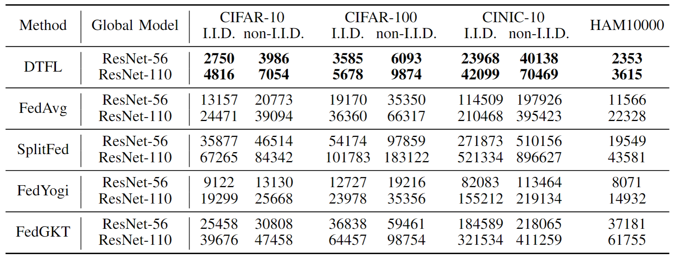
Training Time Improvement
Fast
80%+ reduction in training time

Slide 20
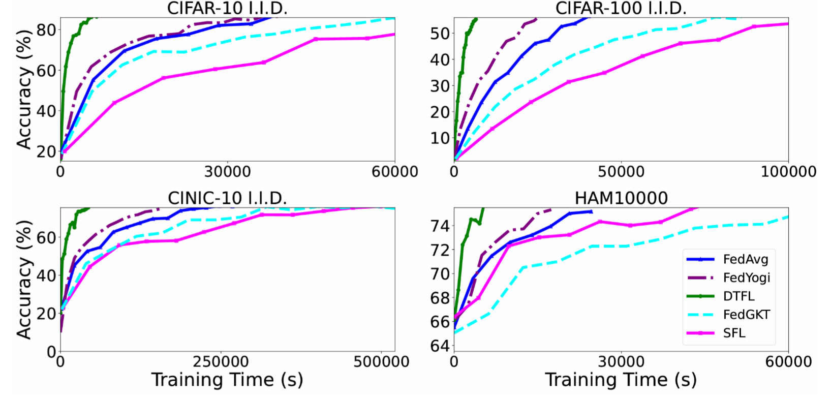
Training Time Improvement
Training time difference

Slide 21
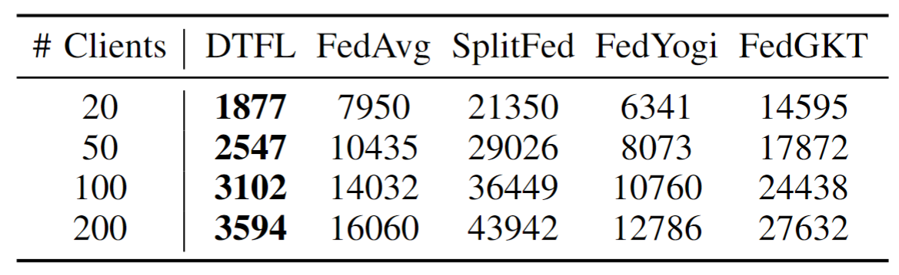
Scalability
Scalable

Slide 22
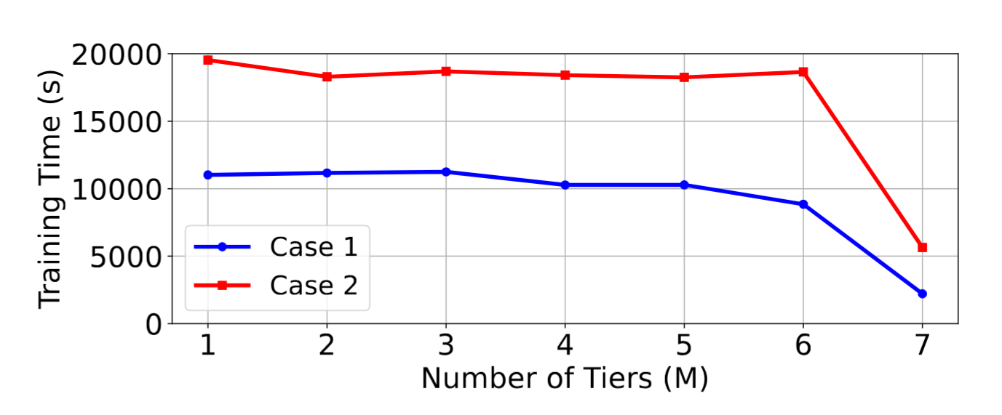
Number of Tiers Impact
More Tiers:
Decrease training time
Might harm accuracy
Notes:
Num of tiers

Slide 23
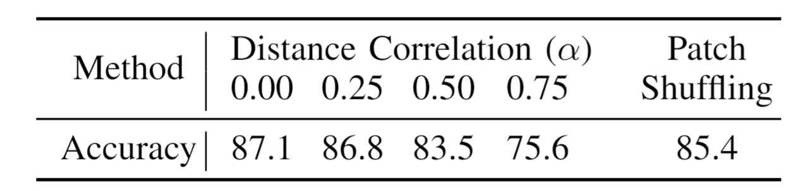
Privacy Preservation
Model Parameters
Intermediate data
Secure
Intermediate data: P Vepakomma, Nopeek, 2020 And D Yao, Patch shuffling, 2022
Model Parameter: Differential privacy, M Abadi, 2016
Notes:
Why privacy here? Feature map? Issue of SL. The method is ortogonal
How about diferential privacy

Slide 24
Main Takeaway from DTFL
Tiered Federated Learning
Efficiently distributes training tasks in heterogeneous edge networks.
Dynamic Tier Scheduling
Assigns clients to optimal tiers dynamically, reducing training time.
Theoretical Guarantees:
Proven convergence analysis ensures performance reliability.
Experimental Results
Significant reduction in training time while maintaining model accuracy.
Efficient privacy protection without performance trade-offs.
DTFL enhances distributed ML through dynamic tier scheduling, achieving faster training

Slide 25
Decentralized Machine Learning
Communication-Efficient Training Workload Balancing for Decentralized Multi-Agent Learning
Notes:
This is another setup in distributed ML. agent = clients

Slide 26
Decentralized Machine Learning
Improved robustness
Better scalability
Heterogeneous devices
Communication bottleneck

Slide 27
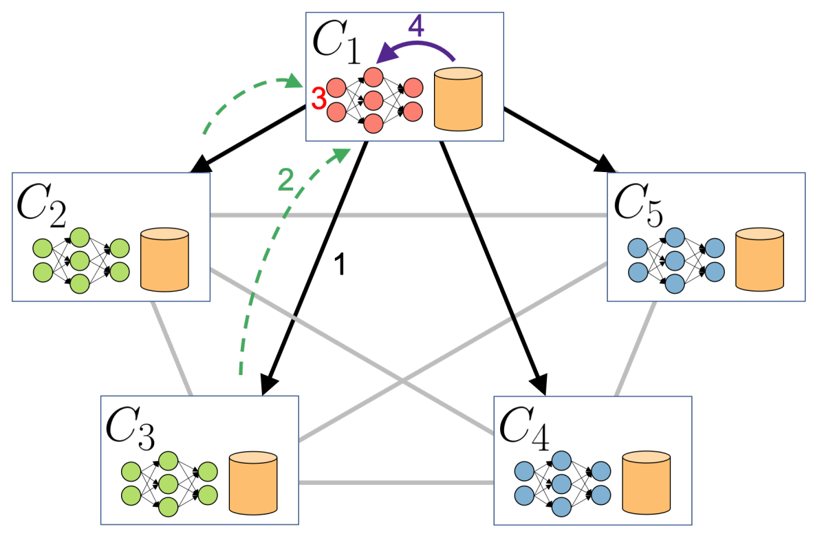
Literature Review - Existing Solutions and Limitations
Decentralized Machine Learning (DML)
Solutions: Peer-to-peer communication.
Gossip Learning, R Ormándi, 2011.
Braintorrent, AG Roy, 2019
GossipFL, Z Tang, 2022
Device heterogeneity
Notes:
GossipFL: there is coordinator but there is only client to client communicaiton

Slide 28
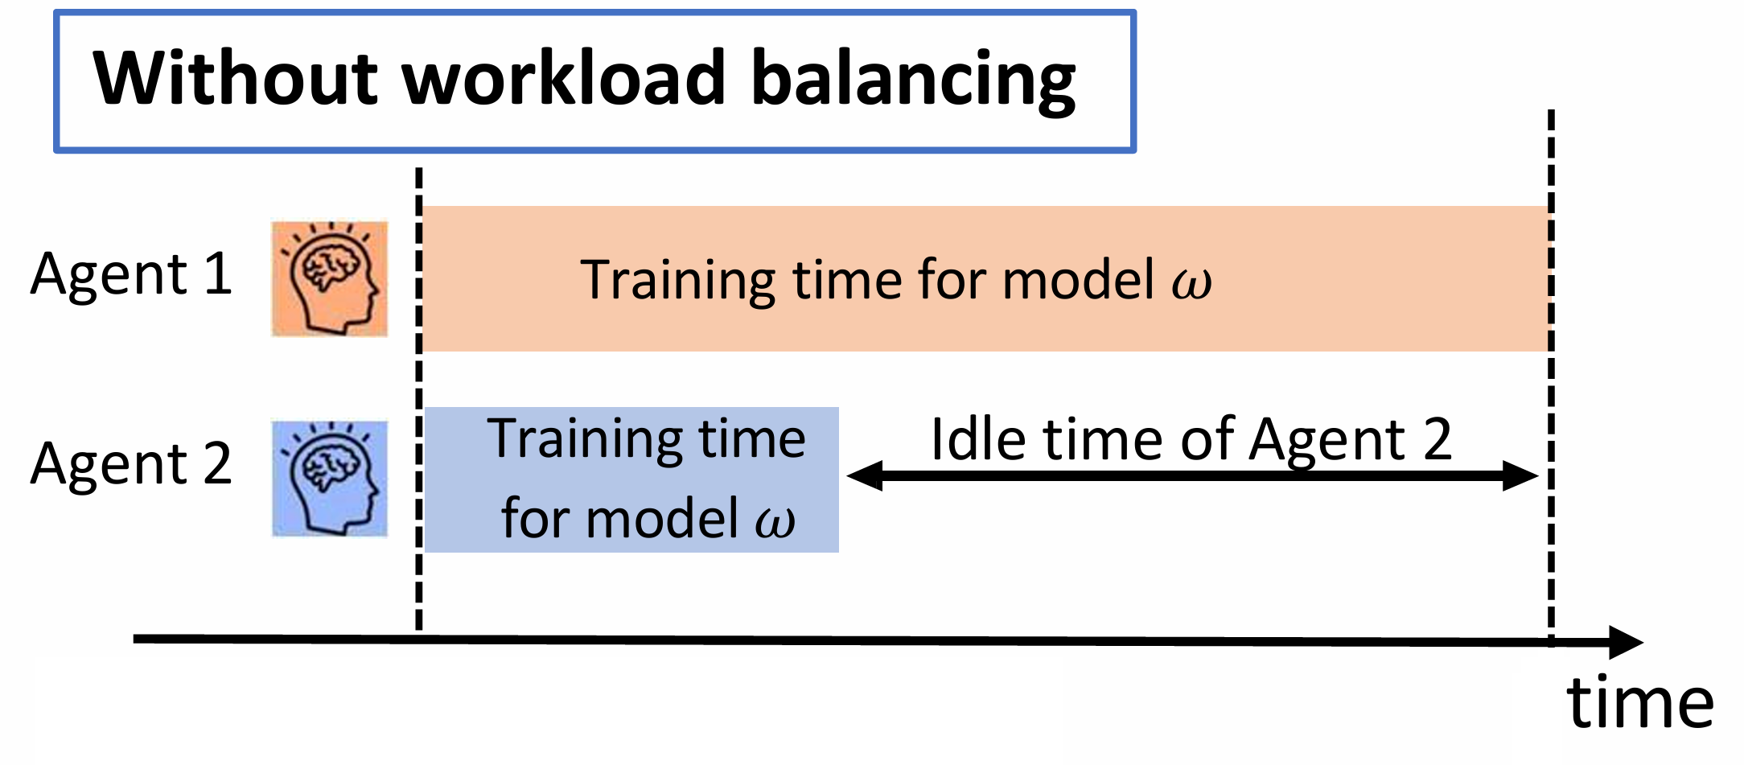
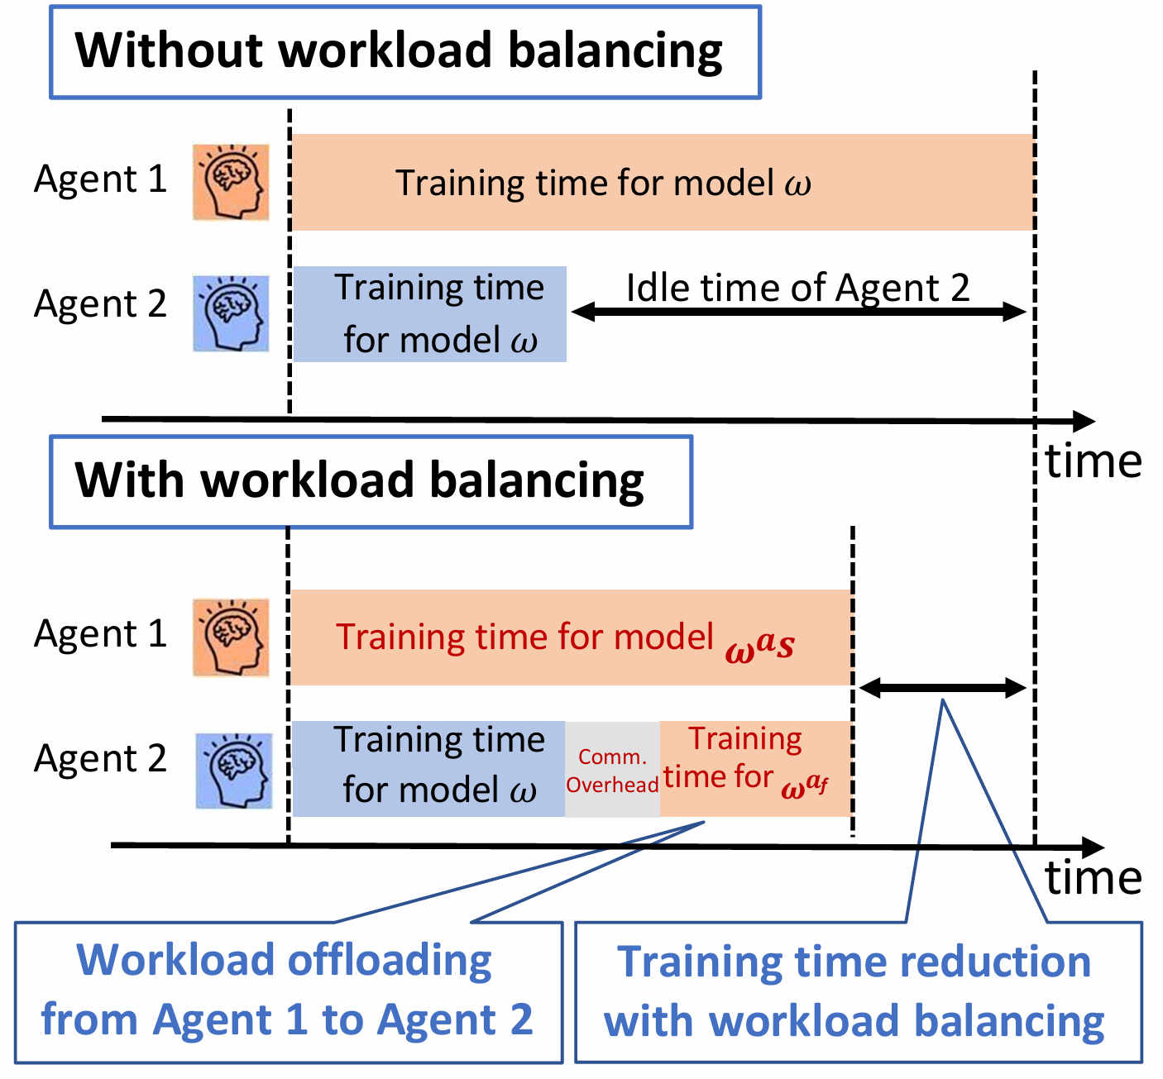
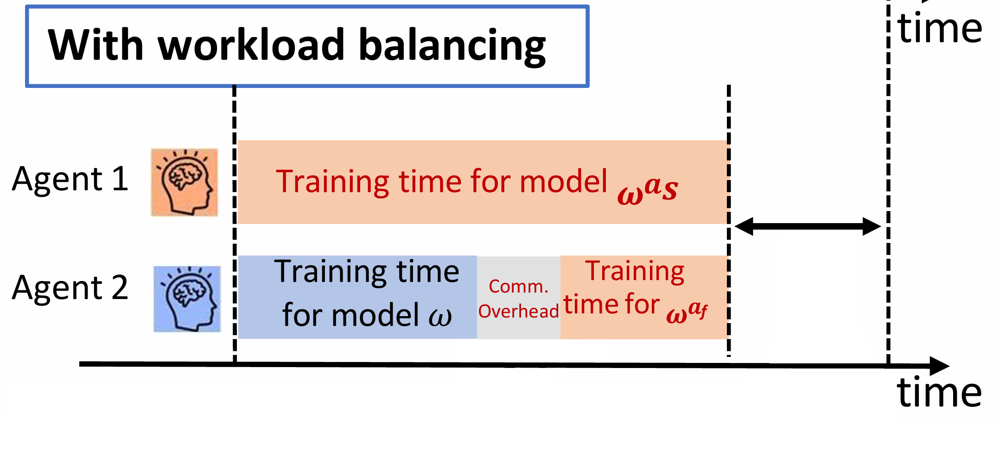



Communication-Efficient Training Workload Balancing
Slow agents hinder training
Imbalanced training time
$$ω^{}$$
$$ω^{a_{s}}$$
$$ω^{a_{f}}$$
Slow agent
Fast agent
Workload offloading from Agent 1 to Agent 2
Training time reduction with workload balancing
Notes:
In dtfl: com time is total com time include the aggregation time, model download an upload. But not have that here. Here

Slide 29
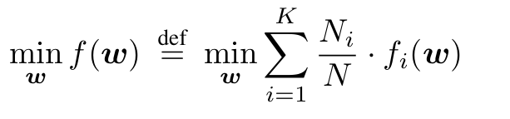
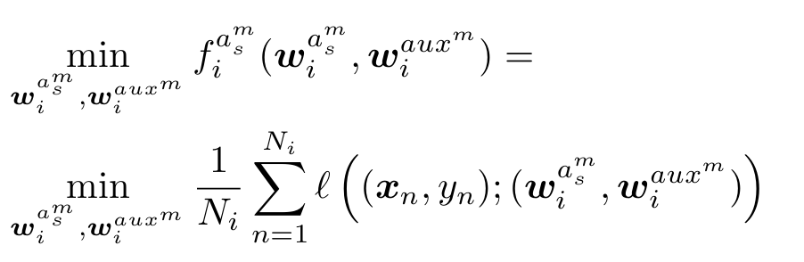
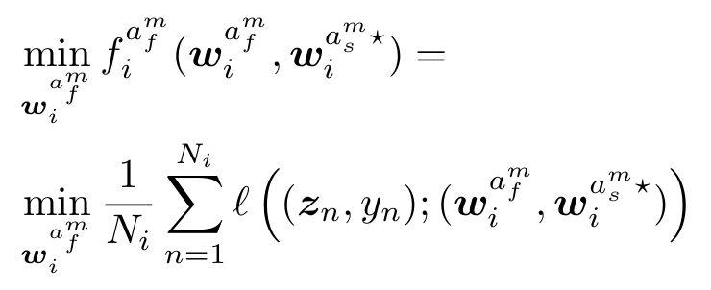

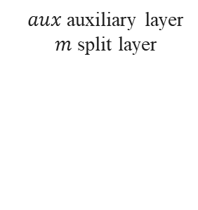

Decentralized Multi-Agent Learning (DML)
Paired agents’ optimization problem
$aux$ auxiliary layer
$m$ split layer
Goal: Minimize training time
$x$ training sample
$y$ label
$z$ intermediate data

Slide 30
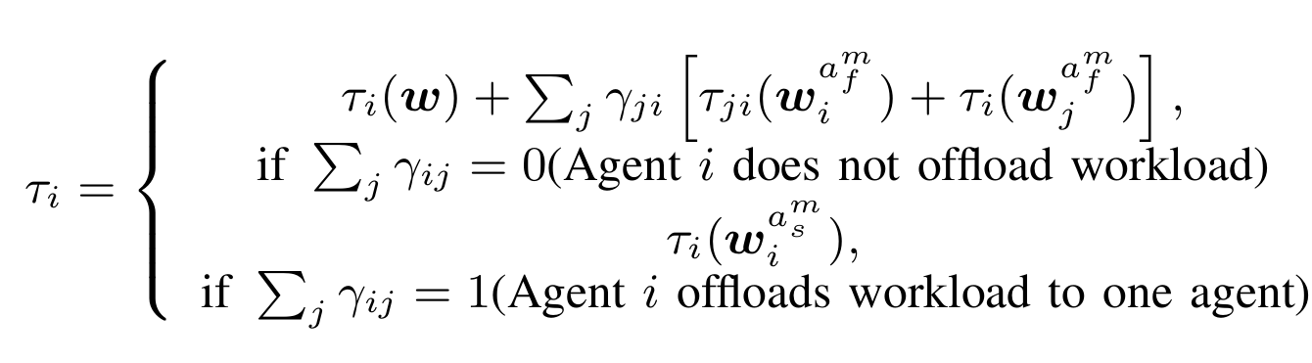
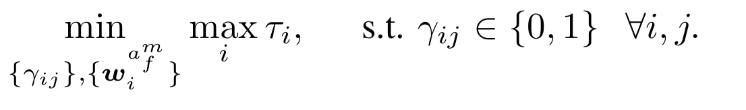
Training Time of DML
Integer programming
Pairing strategy
Workload split

Slide 31

DML Training Challenges
Pairing strategy
4
1
3
How to pair agents?
2
Notes:
Challenges of paper

Slide 32


DML Training Challenges
Workload split
$$x_{i}$$
$$y_{i}$$
Communication synchronization
How to split workload?
Notes:
Challenges of paper

Slide 33
Key Observation - Heterogeneity Impacts on Training
Factors: communication, processing, model splitting
Trade-off: less compute, more transfer
Dynamic offloading is the key for optimal training time
Minimum training time

Slide 34
SplitPair Training Workflow
1
5
Agent Pairing
1
2
4
2
Local Model Update
Model Aggregation
3
3

Slide 35






Training Workflow - Agent Pairing
Agent | Estimated time (s)
1 | 20
2 | 30
3 | ∞
4 | 20
5 | 10
$$τ_{5}≅10(s)$$
5
Agents share processing speed and training time (slowest first).
Each agent observes connection speed, estimates paired training time, sends back estimated time and split layer
Each agent chooses a neighbor minimizing training time.
1
2
4
$$τ_{2}≅30(s)$$
$$τ_{4}≅20(s)$$
3

Slide 36
Training Workflow - Local Model Update
1
5
Fast agents train local models independently
Slow agents train locally & receive fast agent support
2
4
3
2
Local-loss training

Slide 37
Training Workflow - Model Aggregation
3
1
5
3
3
2
4
3
3
3
2
Model aggregation using All-Reduce

Slide 38
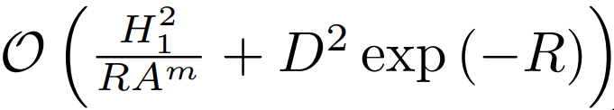
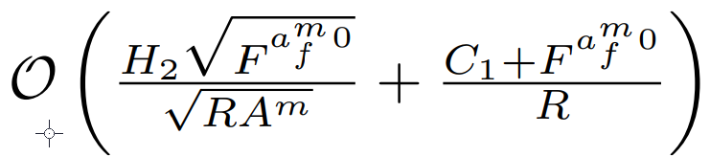
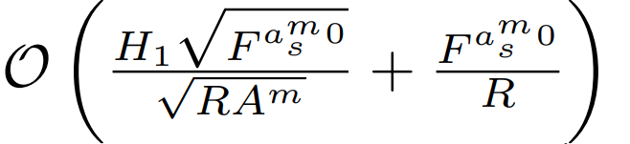
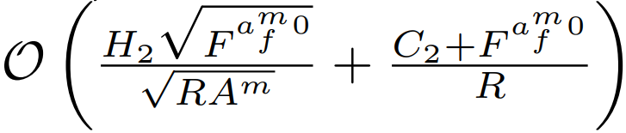
Convergence Analysis
Theorem: Slow and fast agent-side models for both convex and non-convex functions converge with SplitPair algorithm
 | Slow-agent side | Fast-agent side
Convex
Non-convex
Similar convergence rates to FL
Convergence depends on slower agents ($C_{1}$and $C_{2}$)
Notes:
What is C1, C2, hightligt challenges of proof and how address that, why convergence is difficult

Slide 39
SplitPair: Communication Cost
Paired agents exchange high-dimensional feature maps, leading to heavy communication overhead.
1
5
Communication ≈ 52% of training time
2
4
3

Slide 40
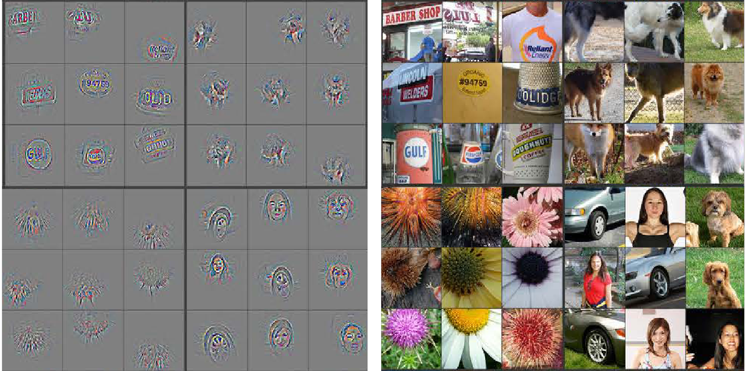
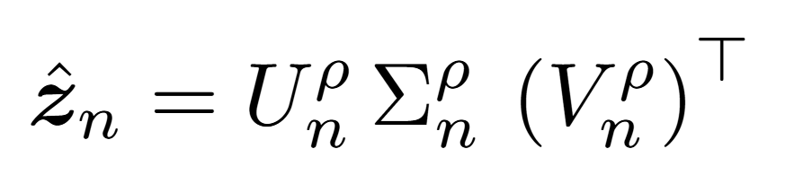

SplitPair: Efficient Communication
Apply Singular Value Decomposition (SVD) to compress intermediate feature maps before transmission.
SVD
Compressed Representation
Input Images
Feature Maps
Visualizing and understanding convolutional networks: MD Zeiler, R Fergus, 2014
$z$ intermediate data
top ρ singular values
Notes:
European conference on computer vision

Slide 41
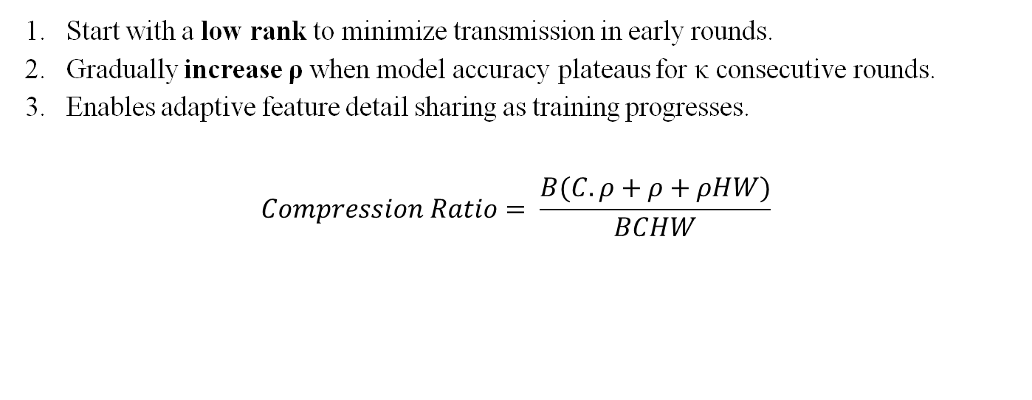
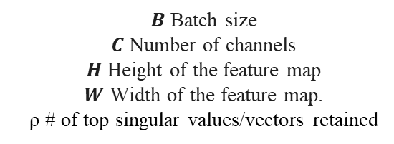
Dynamic Rank Adjustment
Start with a low rank to minimize transmission in early rounds.
Gradually increase ρ when model accuracy plateaus for κ consecutive rounds.
Enables adaptive feature detail sharing as training progresses.
$$Compression Ratio= \frac{B(C.ρ+ρ+ρHW)}{BCHW}$$
$B$ Batch size
$C$ Number of channels
$H$ Height of the feature map
$W$ Width of the feature map.
ρ # of top singular values/vectors retained
Notes:
$B \cdot (C\rho + \rho + \rho HW)$

Slide 42


Evaluation Setup
Implementation:
  Hardware: Intel Xeon(R) CPU & NVIDIA GeForce GTX GPUs
  Software: Python, PyTorch
  Heterogeneous simulation environment
    4, 2, 1, 0.5, and 0.2 CPUs.
    0, 10, 20, 50, and 100 Mbps
Model Architecture:
  ResNet-56
  ResNet-110
Baselines:
  FedAvg
  BrainTorrent
  Gossip Learning
  AllReduce
Datasets:
  CIFAR-10, CIFAR-100, CINIC-10
  Non-IID variants for label distribution skew

Slide 43
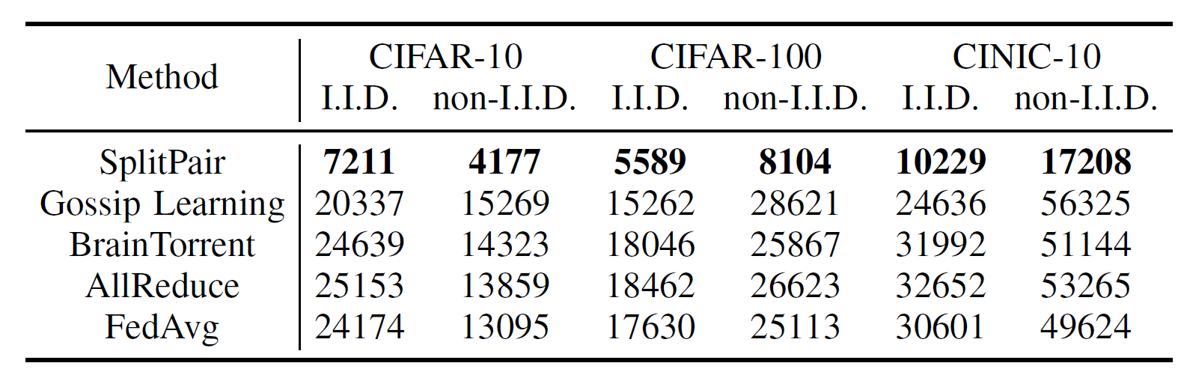
Training Time Improvement
Fast
70%+ reduction in training time

Slide 44
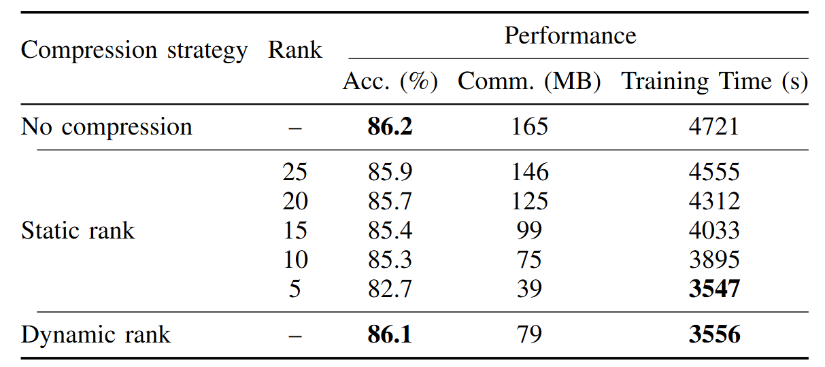
Feature Map Compression

Slide 45
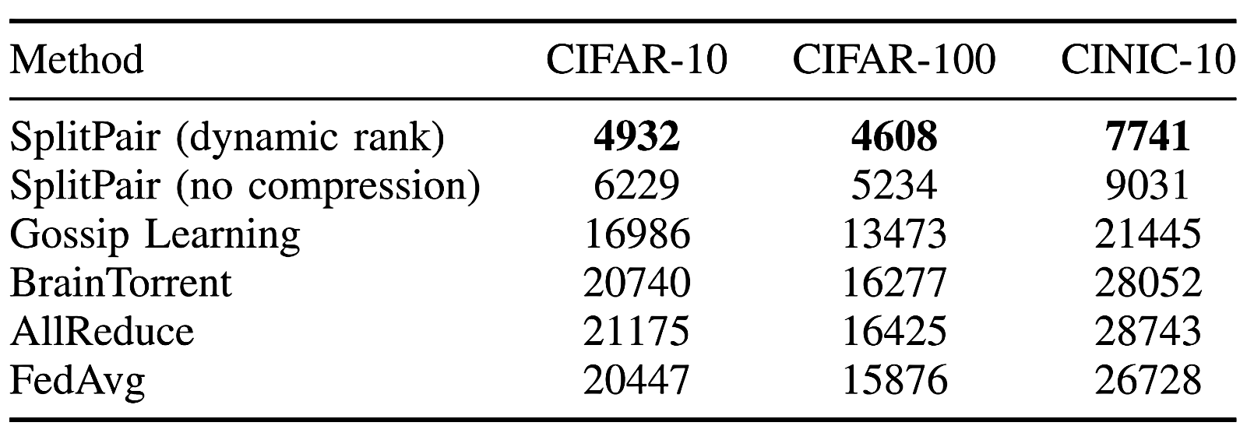
Compression with Dynamic Rank
Dynamic rank enhances the framework by applying compression to the feature maps.
Accelerating Decentralized Learning with Compression

Slide 46

Scalability
Scalable

Slide 47



Robustness under Different Network Topologies
Under limited connections (20% links)
Robust
Training time difference

Slide 48
Privacy Preservation
Intermediate data
Model Parameters
Secure
 | No protection | Distance correlation | Patch shuffling | Differential privacy
Accuracy | 84.6% | 81.7% | 83.2% | 77.6%
Intermediate data: P Vepakomma, Nopeek, 2020 And D Yao, Patch shuffling, 2022
Model Parameter: Differential privacy, M Abadi, 2016

Slide 49
Main Takeaway from SplitPair
Decentralized ML
Resource-Aware Scheduling
Balances workload effectively for parallel updates.
Accelerates training time through efficient resource utilization
Convergence Guarantees
Ensures model convergence in decentralized settings.
Scalable and Robust
Adapts to an increasing number of heterogeneous edge devices.
Handles diverse and dynamic network conditions.
SplitPair tackles stragglers in decentralized ML through dynamic workload balancing, achieving faster training without a central server

Slide 50
Communication & Storage Efficiency
SOLAR (Subspace-Oriented Latent Adapter Reparameterization)

Slide 51



Communication & Storage Challenges of Foundation Models
Models become larger
Communication challenges in edge networks
Foundation Model

Slide 52





Literature Review — LoRA
Bounded by the rank ($r$) and $W$dim (≈ 2048–4096)
Hu, Edward J., et al. "Lora: Low-rank adaptation of large language models." arXiv preprint arXiv:2106.09685 (2021).

Slide 53




















Literature Review — NOLA
$$B_{1}$$
$$B_{2}$$
$$B_{N_{B}}$$
$$×$$
$$β_{1}$$
$$×$$
$$β_{2}$$
$$×$$
$$β_{N_{B}}$$
$$+$$
Performance depends on large pool of random bases.
No use of foundation model ($W$).
Foundation model
$$W$$
$$B$$
Pseudo-random generator
$$A$$
Memory and communication demand for 1,000 customized GPT-3 models:
LoRA: 35GB
NOLA: 7GB
Seed
$$+$$
$$α_{1}$$
$$×$$
$$α_{2}$$
$$×$$
$$α_{N_{A}}$$
$$A_{1}$$
$$A_{2}$$
$$A_{N_{A}}$$
Koohpayegani, Soroush Abbasi, et al. "NOLA: Compressing LoRA using Linear Combination of Random Basis." The Twelfth International Conference on Learning Representations., 2024

Slide 54



Similarity Between 𝑊 and ∆𝑊 Subspaces
$W$ is more similar to $∆W$ than to a random matrix.
$i$ index from $W$
$j$ index from $∆W$
$∅$ similarity measure
Hu, Edward J., et al. "Lora: Low-rank adaptation of large language models." arXiv preprint arXiv:2106.09685 (2021).

Slide 55


Fine-Tuning Aligns with Foundation Subspace
$∆W$ is low-dimensional and lies within the same subspace as $W$, a property emerging from NTK and Neural Collapse dynamics.
Jacot, Arthur, et. al., ."Neural Tangent Kernel: Convergence and Generalization in Neural Networks."Advances in Neural Information Processing Systems 31 (2018).
Malladi, Sai Praveen, et al."Kernel Regression with Infinite-Width Neural Networks on the Sphere."arXiv preprint arXiv:2210.05643 (2023).
Seleznova, Maria, et al."Neural Collapse in Deep Linear Networks: From Balanced Gradients to Representational Alignment."arXiv preprint arXiv:2305.16427 (2023).

Slide 56



Leveraging W–ΔW Similarity for Random Bases
$$B_{1}$$
$$B_{2}$$
$$B_{N_{B}}$$
Foundation model
$$W$$
$$B$$
Pseudo-random generator
$$A$$
Seed
$$A_{1}$$
$$A_{2}$$
$$A_{N_{A}}$$

Slide 57

SOLAR (Subspace-Oriented Latent Adapter Reparameterization)
A framework that compresses LoRA adapter by exploiting the shared subspace between the W and ΔW.
SOLAR
Compression
Foundation model
$$W$$
$$B$$
$$B$$
$$\tilde{B}$$
$$A$$
$$A$$
$$\tilde{A}$$
1
Subspace-oriented randomized bases
2
Sparse selection of bases
3
Model reconstruction

Slide 58









Step 1: Constructing the Subspace-Oriented Basis Set
0
Initial fine-tuned model
Foundation model
$$W$$
$$B$$
$$B$$
$$A$$
$$A$$
$$W=UΣV^{T}$$
Random basis set $ℳ_{B}$
Pseudo-random generator
Random basis set $ℳ_{A}$
Seed
1
Subspace-oriented randomized bases

Slide 59







Step 2: Sparse Selection of Bases
Only communicate / store $α$, $β$, Seed for reconstruction.
0
Initial fine-tuned model
Foundation model
$$W$$
$$B$$
$$B$$
$$U^{T}B$$
$$A$$
$$A$$
$$AV^{}$$
$$W=UΣV^{T}$$
Random basis set $ℳ_{B}$
$$\min_{β}\left\|U^{T}B −\sum{β_{j}M_{B}^{j}}\right\|$$
${Top}_{K}$ selection of $α$and $β$
Consider budget $k_{A}$and $k_{B}$
Pseudo-random generator
Random basis set $ℳ_{A}$
$$\min_{α}\left\|AV−\sum{α_{i}M_{A}^{i}}\right\|$$
Seed
1
Subspace-oriented randomized bases
2
Sparse selection of bases

Slide 60



Step 3: Reconstruction
0
Initial fine-tuned model
Foundation model
$$W$$
$$B$$
$$B$$
$$U^{T}B$$
$$\tilde{B}$$
$$A$$
$$A$$
$$AV^{}$$
$$\tilde{A}$$
$$W=UΣV^{T}$$
Random basis set $ℳ_{B}$
$$\min_{β}\left\|U^{T}B −\sum{β_{j}M_{B}^{j}}\right\|$$
${Top}_{K}$ selection of $α$and $β$
$$\tilde{B}=U\left(\sum{β_{j}^{∗}M_{B}^{j}}\right)$$
Pseudo-random generator
Random basis set $ℳ_{A}$
$$\min_{α}\left\|AV−\sum{α_{i}M_{A}^{i}}\right\|$$
$$\tilde{A}=\left(\sum{α_{i}^{∗}M_{A}^{i}}\right)V^{T}$$
Seed
3
1
Model reconstruction
Subspace-oriented randomized bases
2
Sparse selection of bases

Slide 61

Convergence Analysis
The reconstruction error bound ensures accuracy. The compression error is controlled by the basis pool N and the sparsity budget k.

Slide 62



Experiments
Evaluation Domains:
Vision Transformers (ViT): Image classification tasks in few-shot and full-data settings.
LLaMA Models: Instruction tuning performance on the Alpaca and MMLU datasets.
GPT-2 Models: Language generation quality on the E2E NLG benchmark.

Slide 63

Vision Results - Performance vs. Parameters
Up to 74% fewer parameters.

Slide 64

SOLAR: Extreme Compression
Extreme Compression, Minimal Impact

Slide 65

Effect of Rank & Adapter Placement
Robust Performance Across Configurations

Slide 66



SOLAR on LLaMA: Instruction Tuning Results
Efficient Compression for LLaMA Models

Slide 67


SOLAR on GPT-2: Language Generation Results
Efficient Compression for GPT Models

Slide 68

The Performance vs. Cost Trade-off

Slide 69

Runtime Efficiency & Overhead
Negligible Overhead

Slide 70
Main Takeaway from SOLAR
Post-Training Compression
A post-training framework that compresses adapters without retraining.
Subspace-Oriented Basis
Leverages the model's own subspace to create a highly efficient basis. Communication Efficiency
Reduces adapter size using only sparse coefficients and a single random seed.
SOLAR is a post-training method that compresses PEFT adapter size by leveraging the model's own structure.

Slide 71
Summary
DTFL: A robust and scalable FL framework for training large models on heterogeneous devices.
SplitPair: A decentralized framework for decentralized ML, offering efficient resource utilization and privacy-preserving capabilities.
SOLAR: A post-training compression framework that leverages a model's structure to reduce the communication and storage cost of PEFT adapters.

Slide 72




Future Work: Federated PEFT & Dynamic Resource Adaptation
Federated Fine-Tuning of LLMs via SOLAR
Dynamic Hyperparameter & Rank Adaptation
  Develop Auto-SOLAR — dynamically adjusts adapter structure based on device constraints.
$$B$$
$$A$$
Server
$$B$$
$$A$$

Slide 73
Future Work: Modular Transformer Architecture Adaptation
Memory- and Resource-Adaptive Modular PEFT
Communication-Budgeted Module Sharing
Vaswani, Ashish, et al. “Attention Is All You Need.” Advances in Neural Information Processing Systems (NeurIPS), 2017.

Slide 74
Publications
J. Zhang, L. Yang, S. M. Sajjadi Mohammadabadi, & F. Yan, “A survey on self-supervised learning: Recent advances and open problems” in Neurocomputing Journal, 2025.
S. M. Sajjadi Mohammadabadi, S. Zawad, F. Yan, and L. Yang, “Speed Up Federated Learning in Heterogeneous Environments: A Dynamic Tiering Approach” in IEEE Internet of Things Journal, 2024.
S. M. Sajjadi Mohammadabadi, L. Yang, F. Yan, and J. Zhang, “Communication-Efficient Training Workload Balancing for Decentralized Multi-Agent Learning” in IEEE International Conference on Distributed Computing Systems (ICDCS), Jul. 2024
A. Ghasemkhani, R. Sanjeev Haridas, S. M. Sajjadi Mohammadabadi, and L. Yang, “Feature collusion attack on PMU data-driven event classification,” in 2024 IEEE PES Innovative Smart Grid Technologies (ISGT), Washington DC, USA, Feb. 2024.
S. M. Sajjadi Mohammadabadi, Y. Liu, A. Canafe, and L. Yang, “Towards distributed learning of PMU data: A federated learning based event classification approach,” in 2023 IEEE PES General Meeting, Orlando, FL, USA, Jul. 2023.

Slide 75

Thank you!
Questions?
Notes:
Thank you all. Please feel free to ask any questions.
Thank you….

Slide 76


Slide 77

Key Observation - Impact of Tiering on Training Time

Slide 78
Communication-Efficient Training Workload Balancing
Challenge: Slow Agents Hinder Training
Stragglers
Imbalance
Goal: Minimizing training time
Our Solution: ComDML
Balances Workload
Reduces Communication

Slide 79
Tiering Challenges
Training time for all tiers
Tier 3
Tier 2
Tier 1
How does tier change impact training time?

Slide 80

Key Observation – Tiers and Training Time Relationship
Normalized training time is the same across different tiers
Normalized training time to tier 1
Notes:
relative to Tier 1

Slide 81
Tiering Challenges
Dynamic capacities
Tier 3
Tier 2
Tier 1

Slide 82
Tiering Challenges
Dynamic capacities
Tier 3
Tier 2
Tier 1
How to choose tier?

Slide 83
Convergence Analysis
Theorem: Client side and server side models for both convex and non-convex functions converge with DTFL algorithm
 | Slow-agent side | Fast-agent side
Convex
Non-convex
Similar convergence rates to FL
Convergence depends on slower agents ($C_{1}$and $C_{2}$)

Slide 84
Evaluation Setup
Implementation:
  Hardware: Intel Xeon(R) CPU & NVIDIA GeForce GTX GPUs
  Software: Python, PyTorch
  Heterogeneous simulation environment
    4, 2, 1, 0.2, and 0.1 CPUs.
    10, 30, and 100 Mbps
Model Architecture:
  ResNet-56
  ResNet-110
Baselines:
  FedAvg
  SplitFed
  FedYogi
  FedGKT
Datasets:
  CIFAR-10, CIFAR-100, CINIC-10, HAM10000
  Non-IID variants for label distribution skew
Notes:
Yogi optimizer. It incorporates elements of both adaptive learning rates and momentum to handle non-convex optimization problems in federated learning scenarios

Slide 85
Evaluation Setup
Implementation:
  Hardware: Intel Xeon(R) CPU & NVIDIA GeForce GTX GPUs
  Software: Python, PyTorch
  Heterogeneous simulation environment
    4, 2, 1, 0.5, and 0.2 CPUs.
    0, 10, 20, 50, and 100 Mbps
Model Architecture:
  ResNet-56
  ResNet-110
Baselines:
  FedAvg
  BrainTorrent
  Gossip Learning
  AllReduce
Datasets:
  CIFAR-10, CIFAR-100, CINIC-10
  Non-IID variants for label distribution skew

Slide 86

Key Observation

Slide 87


Privacy Protection
Flexible Privacy Integration
Model Training:
Fast Agents: Unidirectional communication.
Slow Agents: Protect intermediate data with privacy techniques (e.g., PixelDP noise layer, patch shuffling, distance correlation, and SplitGuard).
Model Aggregation:
Model compartmentalization
Differential privacy, and cryptography
Vepakomma, Praneeth, et al. "Reducing leakage in distributed deep learning for sensitive health data." arXiv preprint arXiv:1812.00564 2 (2019).
Zhen, Xingjian, et al. "On the versatile uses of partial distance correlation in deep learning." European Conference on Computer Vision. Cham: Springer Nature Switzerland, 2022.
Yao, Dixi, et al. "Privacy-Preserving Split Learning via Patch Shuffling over Transformers." 2022 IEEE International Conference on Data Mining (ICDM). IEEE, 2022.

Slide 88
Convergence Analysis
Standard Assumptions:
  L-smoothness
  µ-convexity
  Bounded gradients
  Bounded variance
  Bounded gradient dissimilarity
  Bounded distance

Slide 89




Subspace Similarity
Overlap between 𝑊 and Δ𝑊 subspaces justifies using 𝑊 to construct efficient basis vectors
Develop compact representations of fine-tuned models for scalable deployment.

Slide 90

Only communicate / store $α$, $β$, Seed for reconstruction.
0
Initial fine-tuned model
Foundation model
$$W$$
$$B$$
$$B$$
$$U^{T}B$$
$$\tilde{B}$$
$$A$$
$$A$$
$$AV^{}$$
$$\tilde{A}$$
$$W=UΣV^{T}$$
Random basis set $ℳ_{B}$
$$\min_{β}\left\|U^{T}B −\sum{β_{j}M_{B}^{j}}\right\|$$
${Top}_{K}$ selection of $α$and $β$
$$\tilde{B}=U\left(\sum{β_{j}^{∗}M_{B}^{j}}\right)$$
Pseudo-random generator
Random basis set $ℳ_{A}$
$$\min_{α}\left\|AV−\sum{α_{i}M_{A}^{i}}\right\|$$
$$\tilde{A}=\left(\sum{α_{i}^{∗}M_{A}^{i}}\right)V^{T}$$
Seed
3
1
Model reconstruction
Subspace-oriented randomized bases
2
Sparse selection of bases

Slide 91

Step 1: Constructing the Subspace-Oriented Basis Set
Extract Principal Directions via SVD
  Singular Value Decomposition (SVD) on the foundation model's weight matrix
Enrich the Basis with Randomization
  improve the expressive power of this subspace

Slide 92

Step 2: Sparse Selection of Bases
To identify a minimal, yet highly representative, set of basis
Project the Update into the Model's Subspace
  effective because LoRA updates are already naturally aligned with this subspace
Find the Optimal Sparse Representation

Slide 93

Step 3: Budget-Aware Reconstruction
Reconstruct from Sparse Components
  reconstructed using only the selected top-k basis vectors and their corresponding coefficients
  a Balance of Accuracy and Compression
  Possibility of adaptive budget

Slide 94
Vision Experiments - Setup
Foundation Models: ViT-Base (ViT-B) and ViT-Large (ViT-L).
Task: Image Classification on standard benchmarks (CIFAR, Food-101, ImageNet, etc.).
Settings: Evaluated in both full-data and challenging few-shot (10 samples/class) scenarios.
Baselines: Compared against Full Fine-Tuning, LoRA, and NOLA.

